Slide 1



TEAM 2
PROCESSING BIG DATA
FINAL ASSIGNMENT
TOPIC: PERFORM EXPLORATORY DATA ANALYSIS (EDA) AND FEATURE EXTRACTION FROM RAW RECIPE DATA TO DESIGN A RECOMMENDER SYSTEM.
PREPARED BY: TEAM 2 - JACK NGUYEN & VU MANH TRUNG HAI

Slide 2

CONTENT OUTLINE
Assignment Overview
01
Assignment Approach
02
Tasks and Solution
03

Slide 3


ASSIGNMENT OVERVIEW
Key Objective: Perform Exploratory Data Analysis (EDA) and features extraction from raw recipe datasets,
supporting the process designing a recommender system.
Including: 6 required tasks and 3 optional tasks

Slide 4

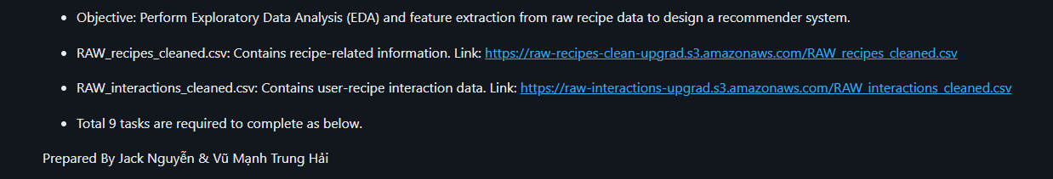
ASSIGNMENT APPROACH
Key approach to implement 9 given tasks is
to import and transfer the two datasets to Python dataframe.

Slide 5

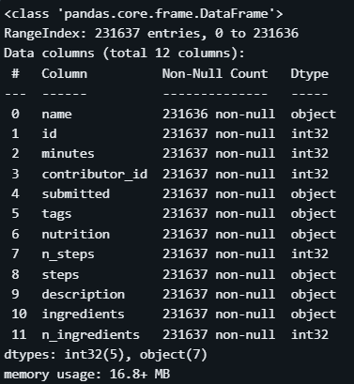
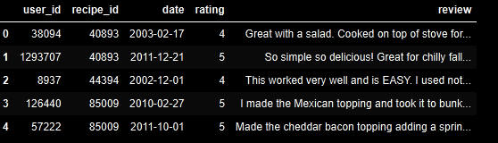
TASKS AND SOLUTION
I. Task 1 - Create New Session - Importing & Reading Dataset
Read RAW_recipes_cleaned.csv from the provided link.
Ensure all fields have the correct data types.

Slide 6
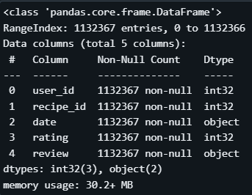
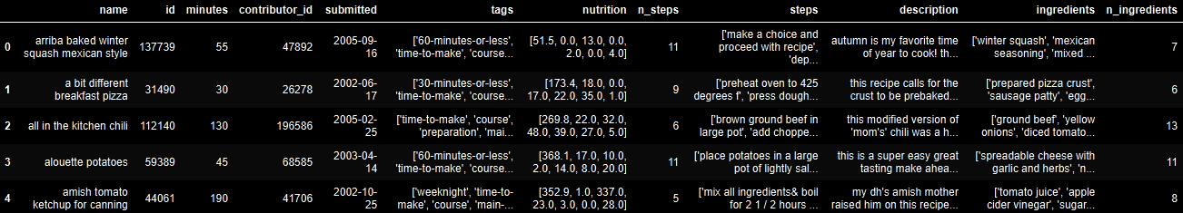
TASKS AND SOLUTION
I. Task 1 - Create New Session - Importing & Reading Dataset
Read RAW interactions from the provided link.
Ensure all fields have the correct data types.

Slide 7

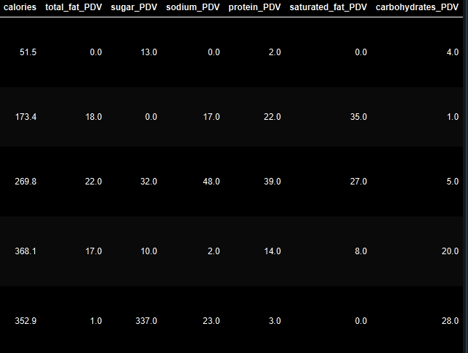
TASKS AND SOLUTION
II. Task 2: Extract Nutrition Features
Extracting the “Nutrition” Column” into individual features, specifically into 7 separate columns:
calories
total_fat_PDV
sugar_PDV
sodium_PDV
protein_PDV
saturated_fat_PDV
carbohydrates_PDV
This helps us easily compare the dataset and usefully for the analysis processing

Slide 8


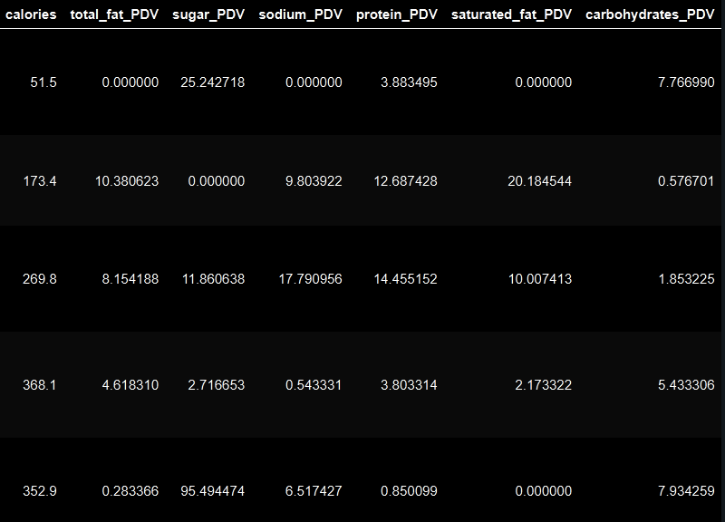



TASKS AND SOLUTION
III. Task 3: Standardize Nutrition Values
TARGET/OBJECTIVE # 1
TARGET/OBJECTIVE # 2
TARGET/OBJECTIVE # 3
Standardize the nutrition values to a per 100 calories basis to account for serving size variations.
Divide each of the nutrition columns (except calories) by the calories value, then multiply by 100.
This helps avoid confusion between nutritional values ​​and allows for fair comparisons between recipes with different serving sizes.

Slide 9


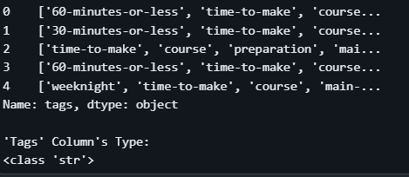


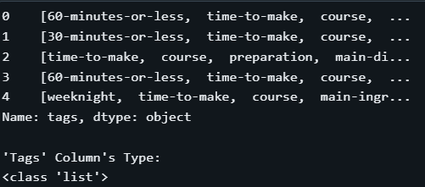
TASKS AND SOLUTION
IV. Task 4: Convert Tags to Array
The tags column is currently read as a string. Convert it to an array of strings for ease of handling.
RESULT:

Slide 10

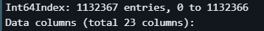
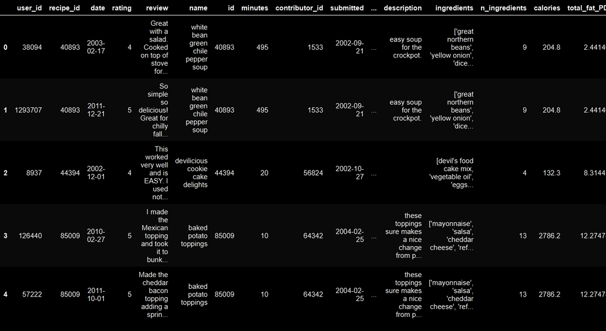
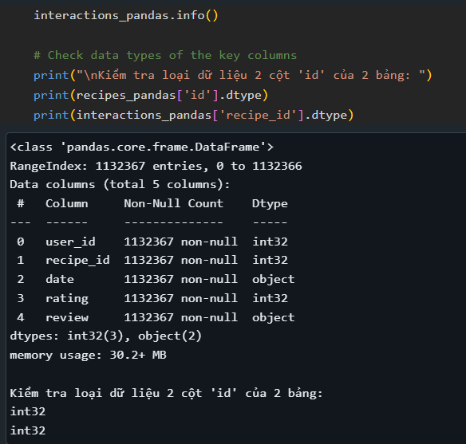
TASKS AND SOLUTION
V. Task 5: Read and Join Interaction Data
Join this interaction data with the recipe data using the appropriate key.
The resulting dataframe contains all interactions with corresponding recipe information.
Creating complete datasets for analysis.
RESULT:

Slide 11



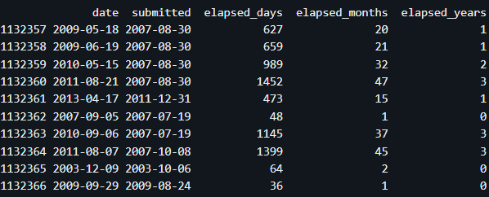


TASKS AND SOLUTION
VI. Task 6: Create Time-Based Features
Create features that capture the time elapsed between a review date and the recipe's submission date.
Helps us analysing the rating based on time.
Helps us analysing the trend of time.
Through this, we can detect the time sample in user behavior.

Slide 12

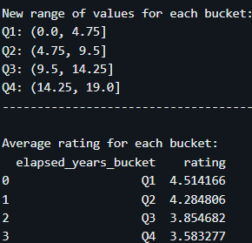
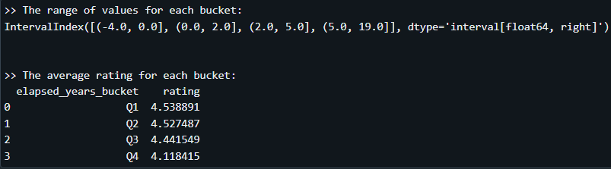
TASKS AND SOLUTION
VII. Task 7: Process Numerical Columns
1. Column years_since_submission_on_review_date - elapsed_years:
Introduce non-linearity to numerical columns by converting them into categorical columns using binning (percentile-based bucketing).
Analyze the average rating for each bucket to determine the usefulness of the bucketed column.
Handle any data inconsistencies or edge cases appropriately.
Drop rows with elapsed_years < 0; and re-calculate the new range and average rating
Create 4 equally spaced bins based on the new range
AFTER:
BEFORE:

Slide 13
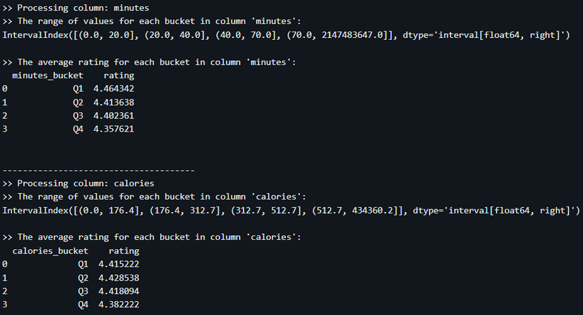
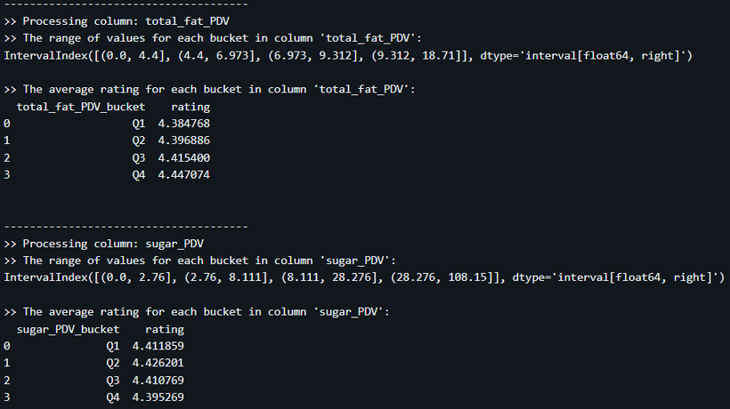
TASKS AND SOLUTION
VII. Task 7: Process Numerical Columns
2. Other columns:
1. minutes:
Q4 range (70.0, 2147483647.0) is disproportionately large compared to other ranges, likely due to an extreme outlier.
Consider filtering out excessively large values (e.g., minutes > 500 or a reasonable threshold).
2. calories:
Q4 extends to 434360.2, another potential outlier. Such a high calorie value may indicate data entry errors or uncommon cases.
Suggest capping calorie values at a plausible limit for human consumption (e.g., 5000).
3. total_fat_PDV:
The range and average rating distribution seem consistent without extreme outliers.
Average rating increases from Q1 to Q4, possibly indicating customer preference for higher-fat content.
4. sugar_PDV:
Q4 extends to 108.15. While possible, values above 100% DV for sugar may warrant closer scrutiny.
The rating in Q4 is lower, possibly indicating customer dissatisfaction with high sugar content.

Slide 14
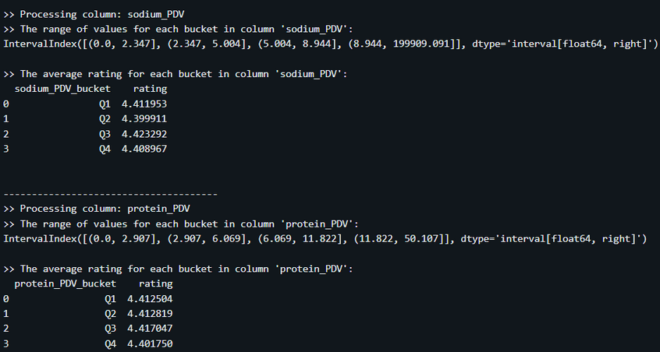
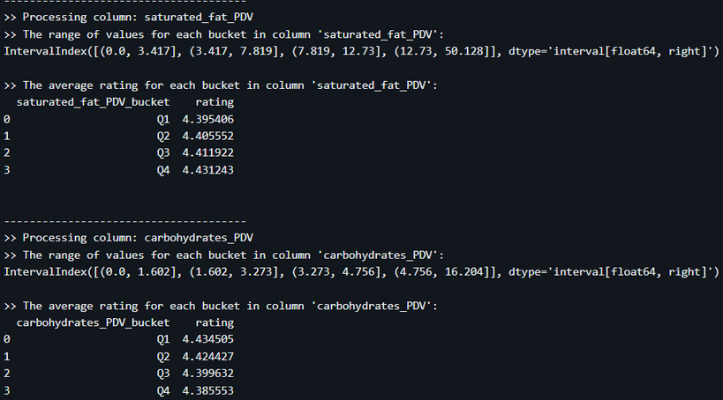
TASKS AND SOLUTION
VII. Task 7: Process Numerical Columns
2. Other columns:
5. sodium_PDV:
Q4 range (8.944, 199909.091) is exceptionally wide, likely skewed by outliers.
Sodium percentage values rarely exceed 200% in realistic scenarios. Consider capping.
6. protein_PDV, saturated_fat_PDV, and carbohydrates_PDV:
Bucket ranges are generally reasonable, though Q4 still contains higher values than most typical datasets.
If these values are critical for analysis, review the data source to validate upper-range accuracy.
7. carbohydrates_PDV:
Q4 extends to 16.204, which is reasonable compared to other columns.
The drop in ratings from Q1 to Q4 aligns with customer concerns about high carbohydrate levels.

Slide 15
TASKS AND SOLUTION
VII. Task 7: Process Numerical Columns
2. Other columns:
OBJECTIVE
1. Outlier Ranges:
Some buckets have unusually large upper limits, such as:
minutes: Q4 extends to 2147483647.0, likely due to outliers.
sodium_PDV: Q4 extends to 199909.091, which may also be an extreme outlier.
These extreme ranges can skew analysis, especially in the Q4 buckets.
2. Rating Consistency Across Buckets:
In most columns, there is a noticeable decrease in average rating from Q1 to Q4 (e.g., minutes, calories, carbohydrates_PDV).
This pattern might reflect diminishing customer satisfaction or other factors as the metric increases.
Columns like total_fat_PDV and saturated_fat_PDV show the opposite, with ratings increasing slightly toward Q4.

Slide 16

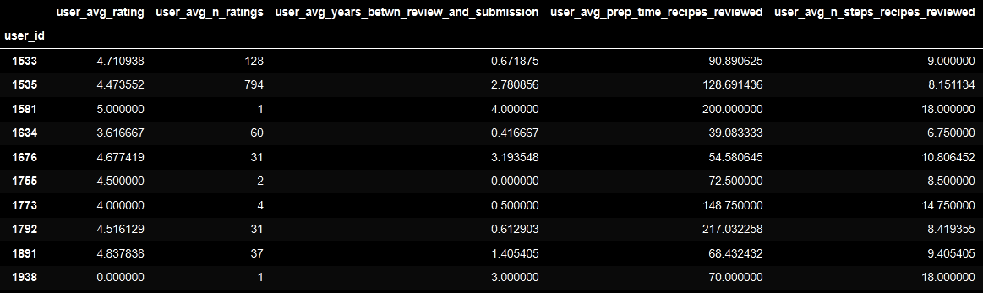
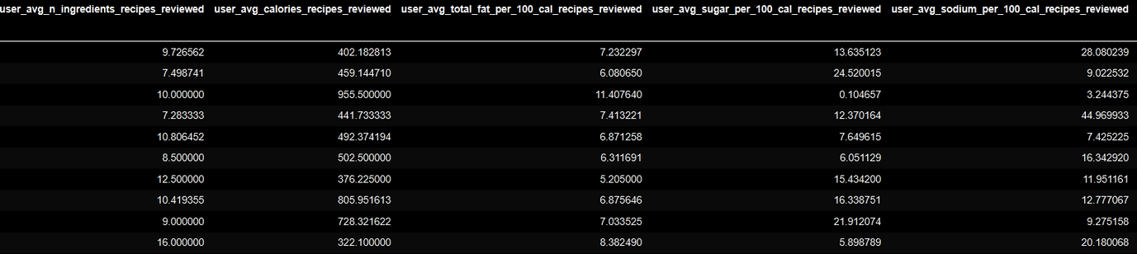
TASKS AND SOLUTION
VIII. Task 8: Create User-Level Features
Object:
Understand user’s preferences through how they rate the recipes
Next --->

Slide 17
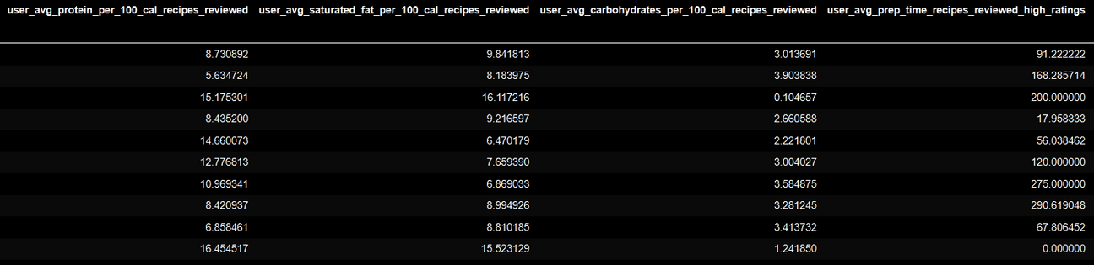
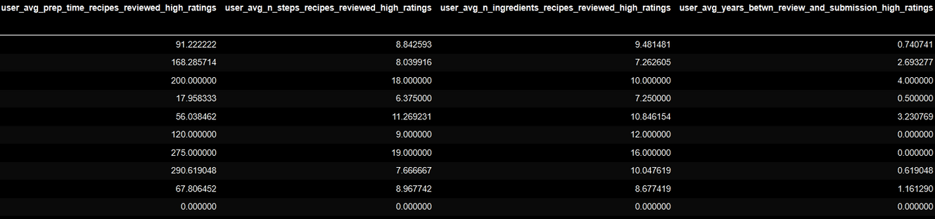
TASKS AND SOLUTION
VIII. Task 8: Create User-Level Features
Next --->

Slide 18
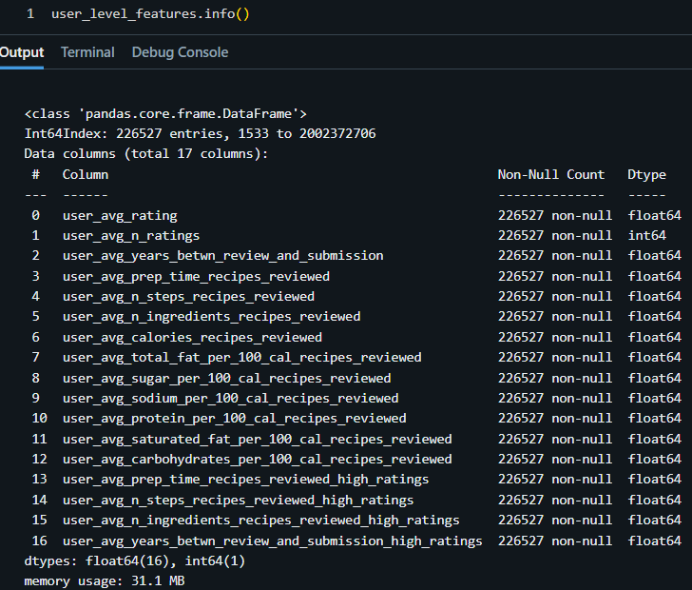
TASKS AND SOLUTION
VIII. Task 8: Create User-Level Features
Post-processing:
Check data thoroughly after creation
Handle null values ​​that may appear during conversion
Next --->

Slide 19
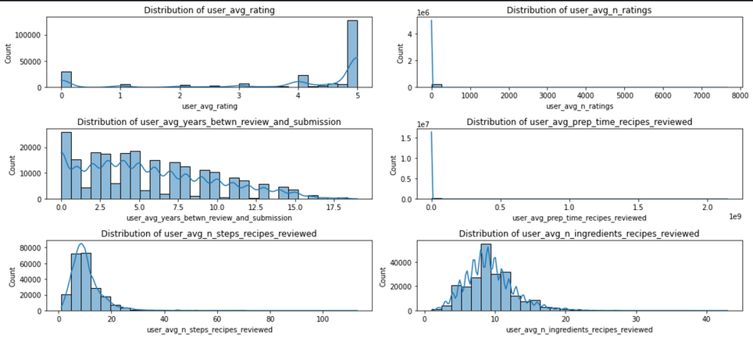
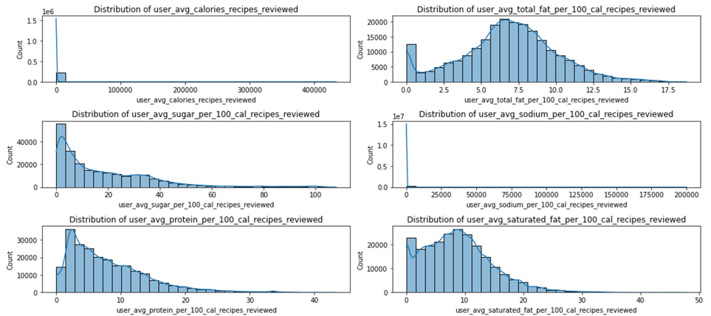
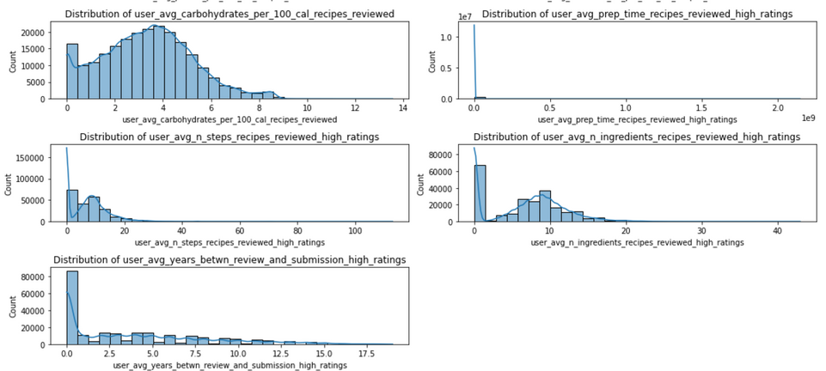
TASKS AND SOLUTION
VIII. Task 8: Create User-Level Features
Next --->

Slide 20




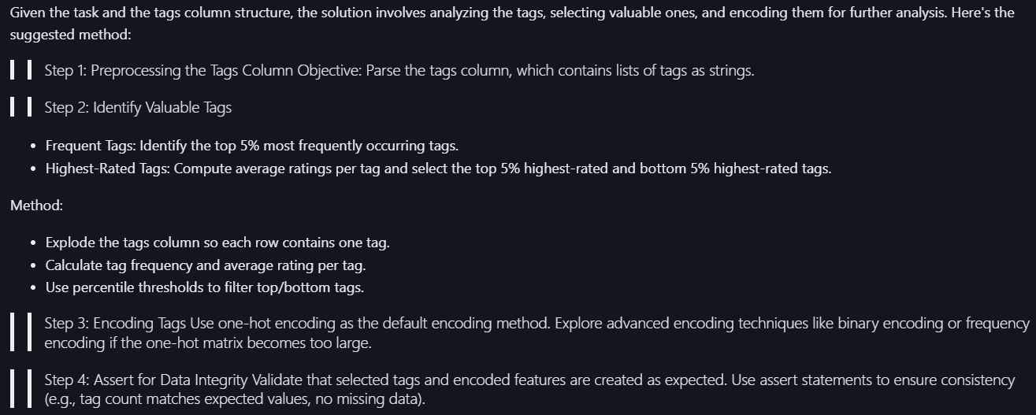











TASKS AND SOLUTION
IX. Task 9: Create Tag-Level Features
APPROACH FOR TASK

Slide 21
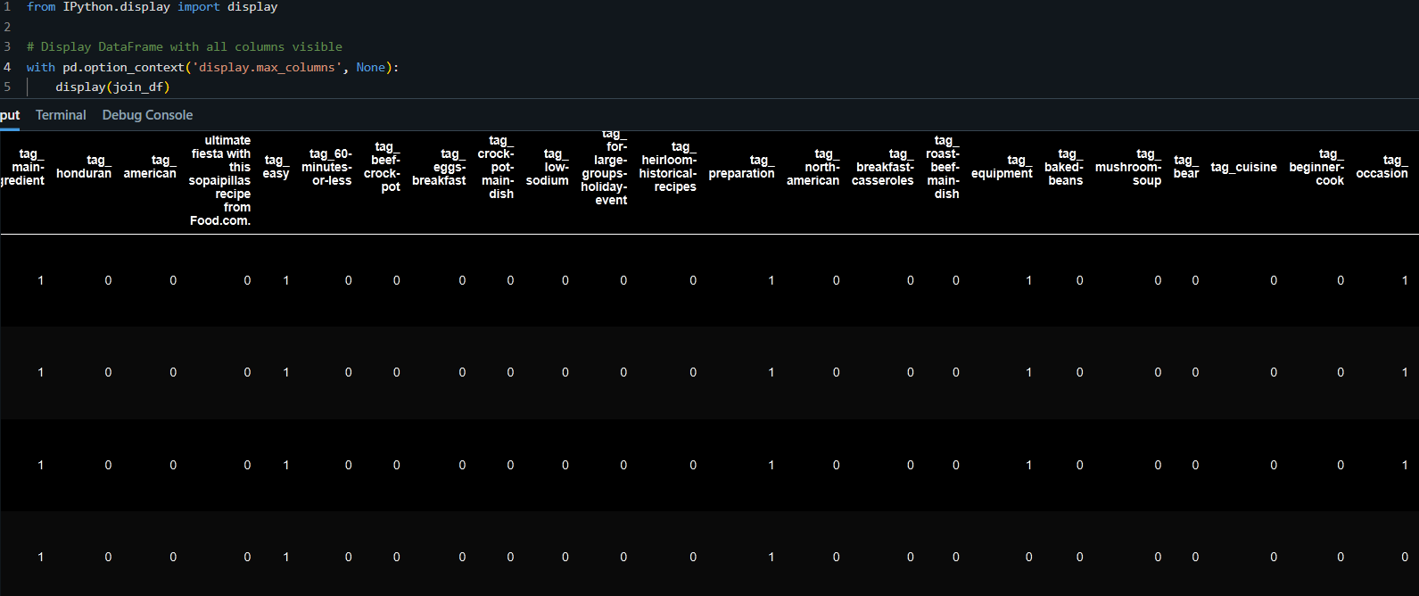
TASKS AND SOLUTION
IX. Task 9: Create Tag-Level Features
EXTRACTING INFORMATION FROM TAGS

Slide 22
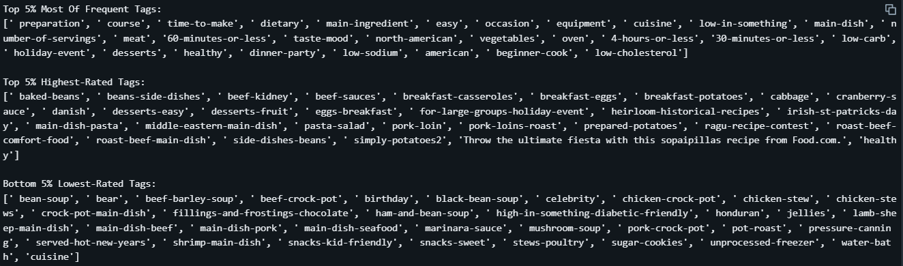
TASKS AND SOLUTION
IX. Task 9: Create Tag-Level Features
EXTRACTING INFORMATION FROM TAGS

Slide 23
THANK YOU

